Slide 1
Numerai as Decentralized AI: Insights from 13F-HR and Operational Costs
Decentralized AI Day (Tokyo)
Saturday, May 17, 2025
Kei Sanada
LinkedIn: Kei Sanada https://www.linkedin.com/in/kei-sanada/
X (Twitter): @sdk7777
Presentation materials in English
The materials used at Decentralized AI Day (Tokyo) can be found starting from page 60.
Decentralized AI Day (Tokyo)で使用した資料はP60から

Slide 2
Disclaimer
･The views expressed in this document are the author's own and do not necessarily reflect those of Numerai, Inc.
･No investment decision or particular course of action is recommended by this document. ･The author assumes no responsibility for any damages incurred as a result of this document.

Slide 3
Summary
･Numerai as Decentralized AI
･Can I analyze the characteristics of Numerai from 13F-HR?
･The operational costs of Numerai as a DeAI
･Not covered in this document:
Future outlook and price predictions for the cryptocurrency Numeraire (NMR)

Slide 4
Numerai as Decentralized AI Revisiting the Paper: Advances in Financial Machine Learning-Numerai’s Tournament If you already know this paper, just let it go. Lopez de Prado, M. (2019). Advances in Financial Machine Learning: Numerai‘s Tournament. Cornell University - Operations Research & Industrial Engineering; Abu Dhabi Investment Authority; True Positive Technologies. Retrieved from https://papers.ssrn.com/sol3/papers.cfm?abstract_id=3478927

Slide 5
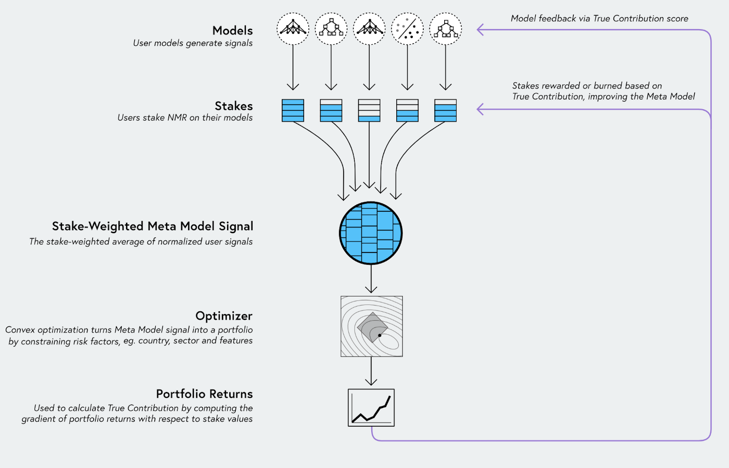
Numerai as Decentralized AI
Numerai Tournament Scoring True Contribution (TC)
https://docs.numer.ai/numerai-tournament/scoring/true-contribution-tc
※True Contribution (TC) is currently not in use.

Slide 6
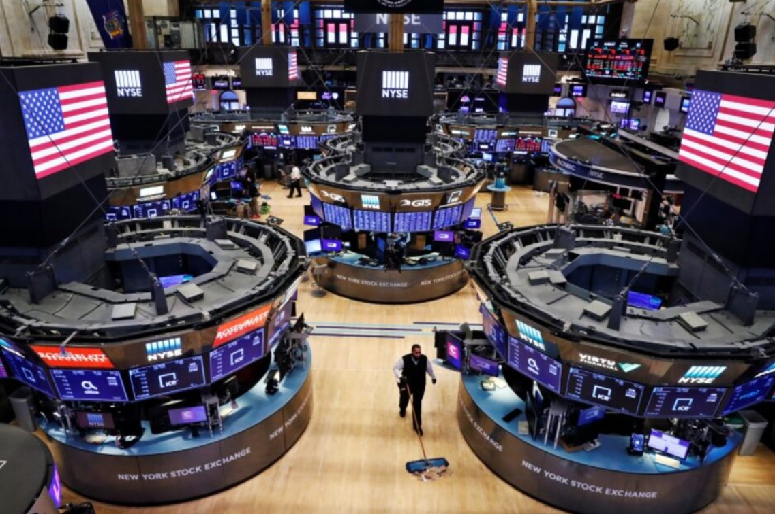
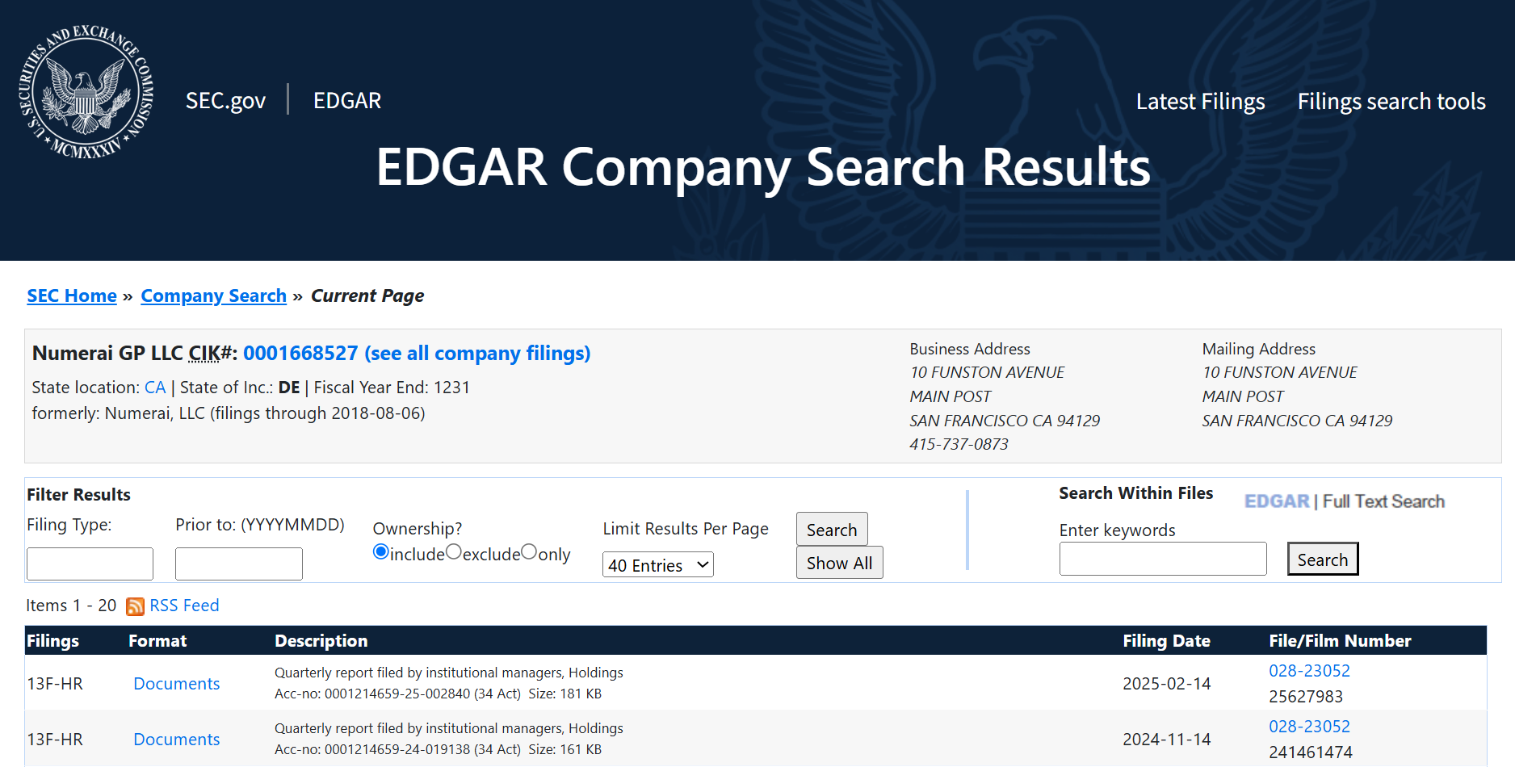

Numerai and Stakeholders
Contestants
World 30 Markets
Market Neutral Strategy
Numerai GP LLC.
Trade
SEC/13F-HR
Report
Institutional investor
Invest
Investment Return
Numerai Tournament Scoring True Contribution (TC)
https://docs.numer.ai/numerai-tournament/scoring/true-contribution-tc
True Contribution (TC) is currently not in use.

Slide 7
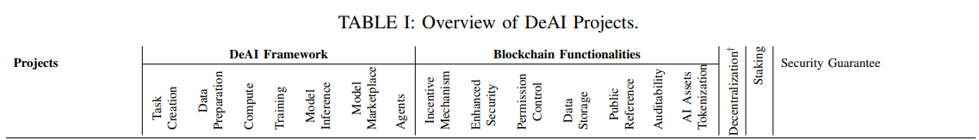
Advances in Financial Machine Learning: Numerai‘s Tournament
･In 2019, when 'Advances in Financial Machine Learning: Numerai’s Tournament' was published, the concept of DeAI was likely not widely recognized. Therefore, Numerai was described using the terms 'Crowdsourced Research' and 'Tournament.’
Lopez de Prado, M. (2019). Advances in Financial Machine Learning: Numerai‘s Tournament. Cornell University - Operations Research & Industrial Engineering; Abu Dhabi Investment Authority; True Positive Technologies.
Retrieved from https://papers.ssrn.com/sol3/papers.cfm?abstract_id=3478927
･In the 2024 paper 'SoK: Decentralized AI (DeAI),' Numerai is presented as a DeAI project.
Wang, Z., Sun, R., Lui, E., Shah, V., Xiong, X., Sun, J., Crapis, D., & Knottenbelt, W. (2024). SoK: Decentralized AI (DeAI). arXiv preprint. https://arxiv.org/abs/2411.17461

Slide 8
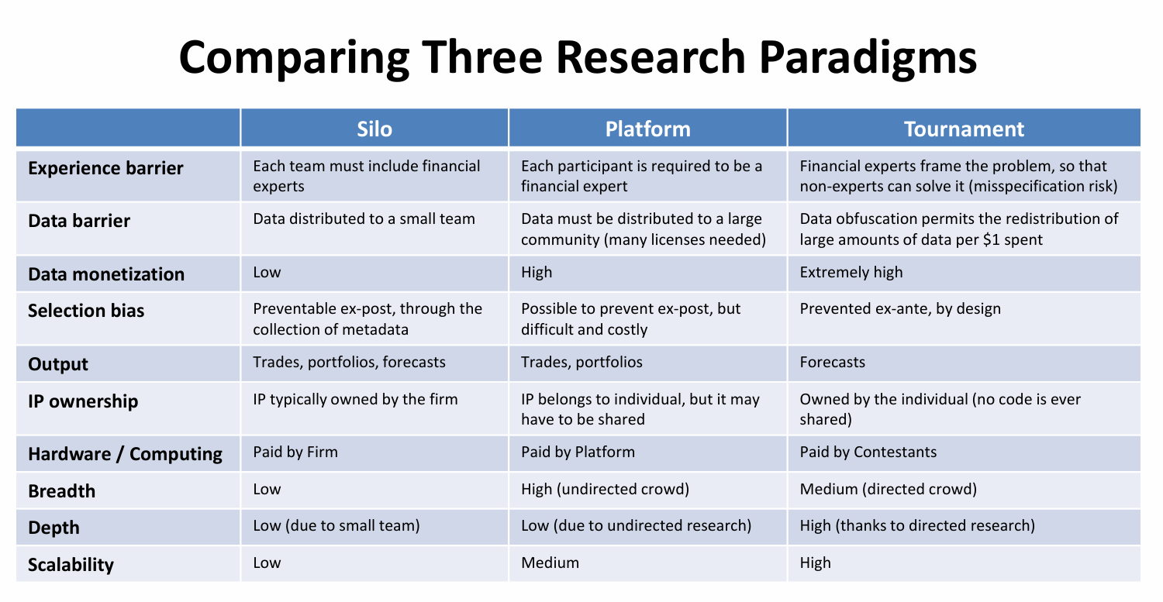
The Handicaps to Modern Quantitative Research
Numerai

Slide 9
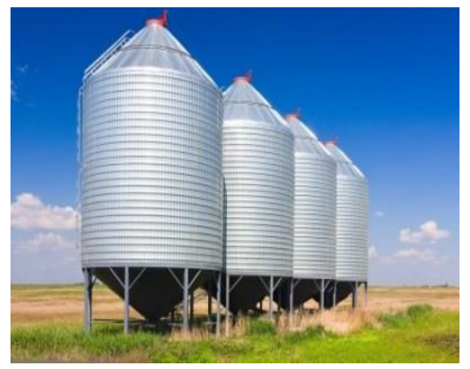
The Handicaps to Modern Quantitative Research:Silo
The Old Paradigm : Silo
Traditionally, quant teams have worked and operated as silos.
A firm’s ability to cover multiple investment strategies is limited by how many teams it can hire.

Slide 10
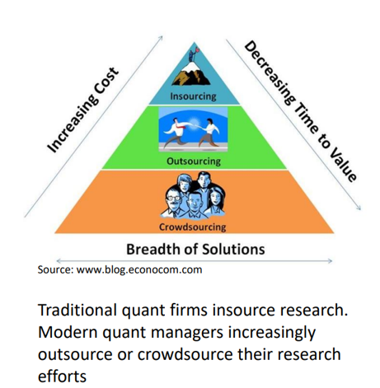
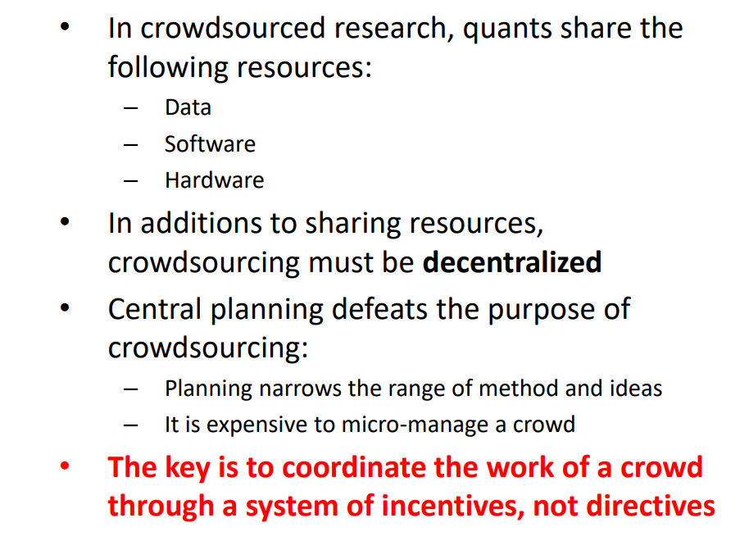
The Handicaps to Modern Quantitative Research: CrowdSourced Resarch
CrowdSourced Resarch

Slide 11
The Handicaps to Modern Quantitative Research:Handicap of Silo
Handicap #1: The experience barrier
To develop an investment strategy, specialized financial knowledge is required. As a result, many data scientists are unable to participate in this field
Handicap #2: The data/resources barrier
Expensive datasets, software, and hardware are required. The era of discovering investment opportunities from publicly available information has ended. Advanced analysis now demands significant financial resources for purchasing, managing, and analyzing complex datasets, as well as for high-performance computers and specialized software.
Handicap #3: Selection bias
Researchers are compensated for creating backtests that demonstrate strong performance, which often leads to model overfitting. Additionally, in some cases, companies may use overfitted backtests to attract investor funds.

Slide 12
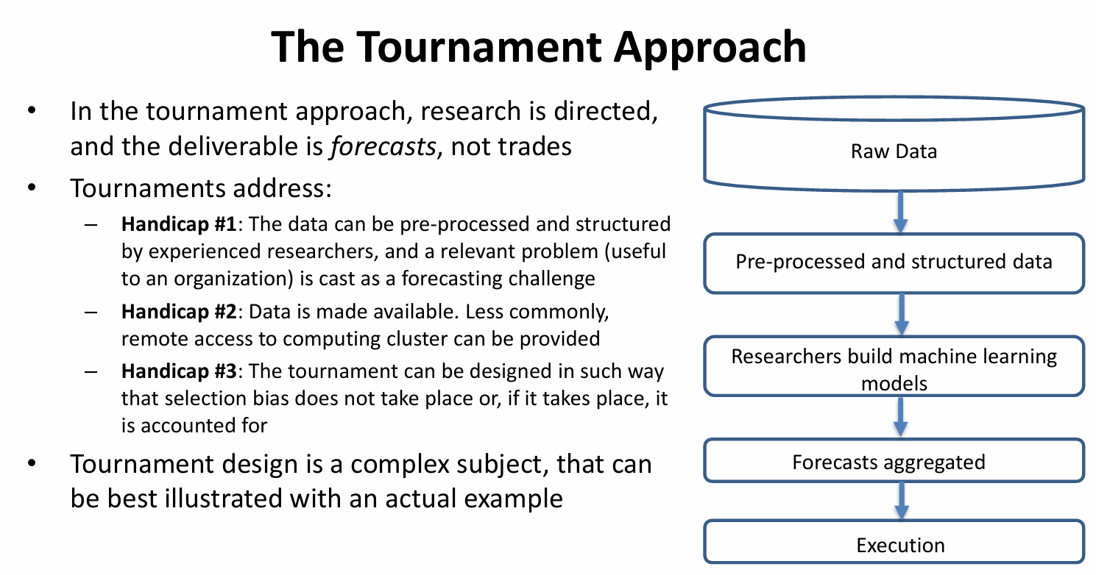
The Handicaps to Modern Quantitative Research: Tournament
Tournament
Handicap #1: The experience barrier
The data can be pre-processed and structured by experienced researchers, and a relevant problem (useful to an organization) is cast as a forecasting challenge.
Handicap #2: The data/resources barrier
Data is made available. Less commonly, remote access to computing cluster can be provided.
Handicap #3: Selection bias
The tournament can be designed in such way that selection bias does not take place or, if it takes place, it is accounted for.

Slide 13
Can I analyze the characteristics of Numerai from 13F-HR?

Slide 14
13F-HR
Institutional investors managing over $100 million in assets are required to submit a 13F-HR report to the SEC on a quarterly basis.
･The securities listed in 13F-HR are long positions; short positions are not included.
･ Only securities traded in the U.S. markets and listed on the SEC’s approved list are reported.
Covered asset types include:
- Equities, shares of closed-end investment companies (closed-end funds), exchange-traded fund (ETF) shares, certain convertible bonds, stock options, and warrants (long positions only).
- Through American Depositary Receipts (ADRs), securities from Japan, Europe, China, and other regions may be included.

Slide 15
Numerai Hedge Fund Holdings and Performance
Numerai Hedge Fund (Numerai GP LLC.) does not disclose its holdings or performance.
※Some articles have been published on Medium.com.
By referencing Numerai Hedge Fund’s 13F-HR filings, one can see its long positions and identify the stocks held at the end of each quarter.

Slide 16
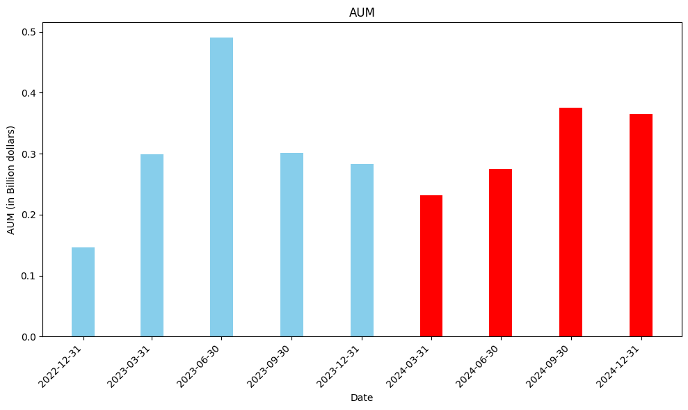
Long Position Assets Under Management (Quarterly)
※Assets Under Management

Slide 17

Performance in 2024
It is likely that 2024 saw steady growth.
https://t.co/n45jK4vLtn

Slide 18
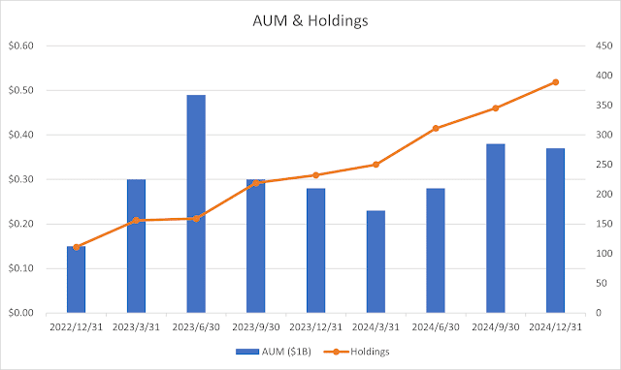
Changes in the Number of Holdings
Date AUM ($1B) Holdings
2022/12/31 $0.15 111
2023/3/31 $0.30 156
2023/6/30 $0.49 159
2023/9/30 $0.30 219
2023/12/31 $0.28 232
2024/3/31 $0.23 250
2024/6/30 $0.28 311
2024/9/30 $0.38 345
2024/12/31 $0.37 389
The correlation between AUM and the number of holdings is weak, with a coefficient of 0.288.
Holdings don’t seem to fluctuate in direct response to AUM changes. Instead, the Numerai team appears to adjust the number of holdings independently to enhance portfolio diversification.

Slide 19
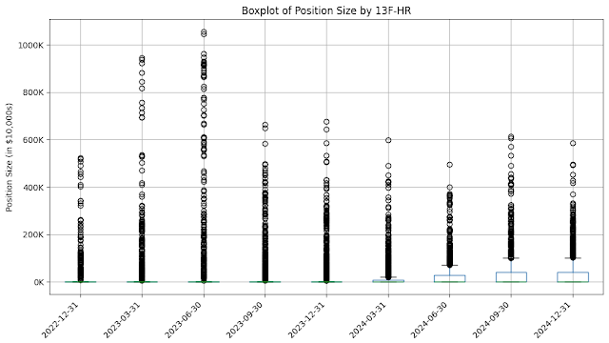
Progress of Diversified Investment Strategy
I created boxplot charts for the position sizes in each 13F-HR.
The initial 13F-HR data presents a surprising deviation, with a notably higher occurrence of upper outliers than anticipated.

Slide 20
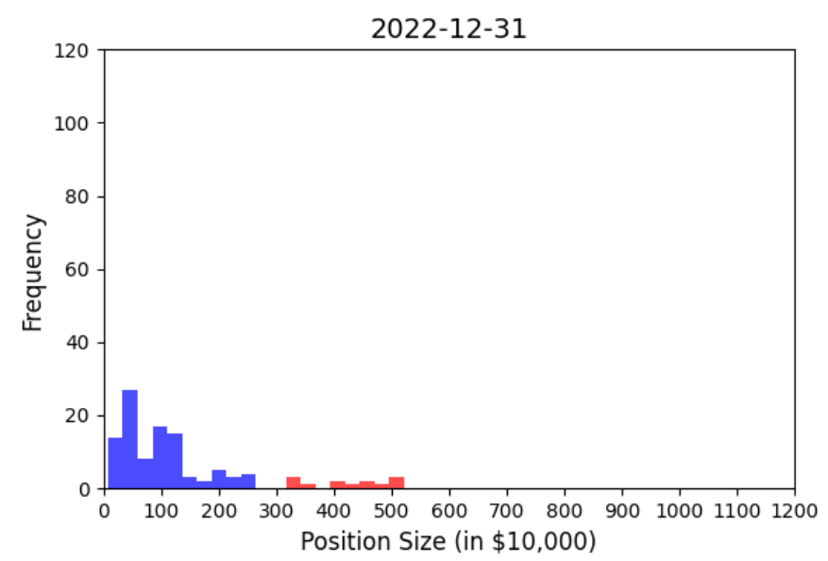
Progress of Diversified Investment Strategy 2022/12~2024/12
Bars with position sizes over $3 million are colored red.

Slide 21
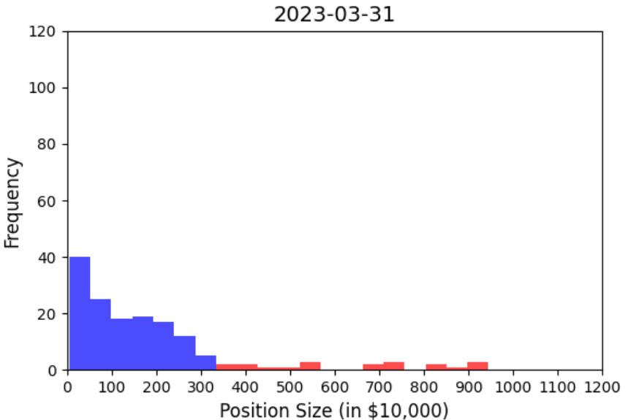
Progress of Diversified Investment Strategy 2022/12~2024/12
Bars with position sizes over $3 million are colored red.

Slide 22
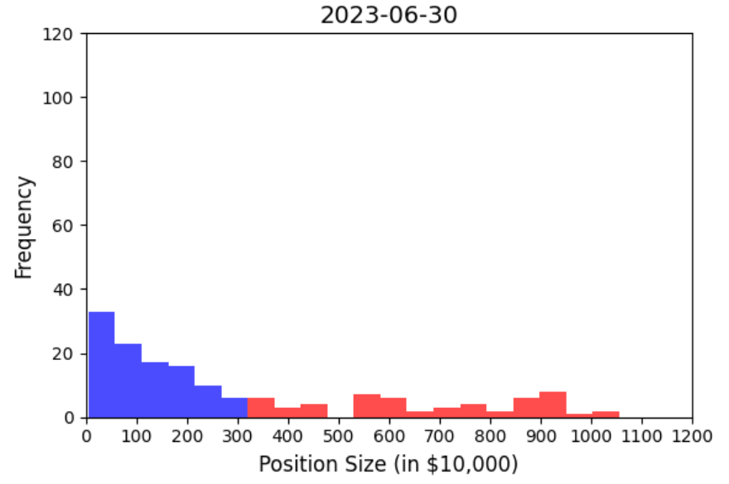
Progress of Diversified Investment Strategy 2022/12~2024/12
Bars with position sizes over $3 million are colored red.

Slide 23
Long Position Assets Under Management (Quarterly)
※Assets Under Management
Did you mess up something?

Slide 24
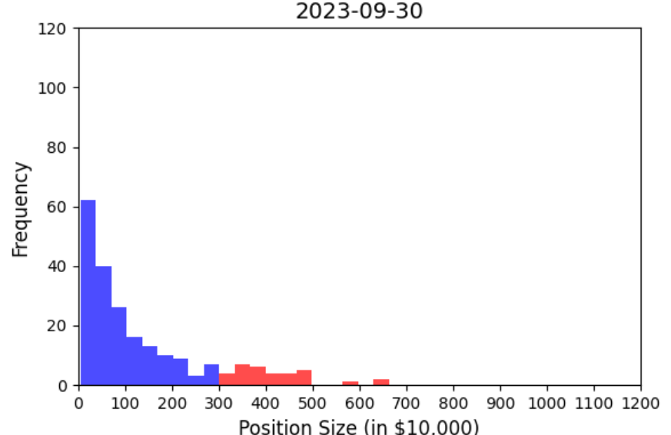
Progress of Diversified Investment Strategy 2022/12~2024/12
Bars with position sizes over $3 million are colored red.

Slide 25
Progress of Diversified Investment Strategy 2023-07~ 2023-09
※Assets Under Management
The diversification of holdings has progressed.

Slide 26
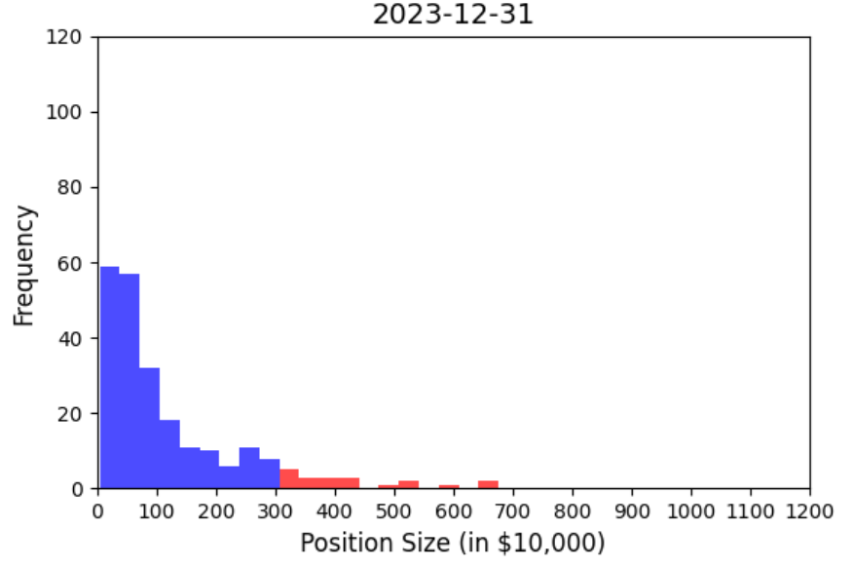
Progress of Diversified Investment Strategy 2022/12~2024/12
Bars with position sizes over $3 million are colored red.

Slide 27
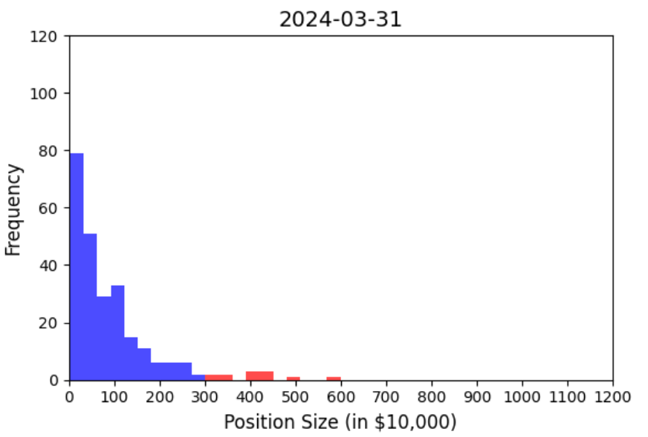
Progress of Diversified Investment Strategy 2022/12~2024/12
Bars with position sizes over $3 million are colored red.

Slide 28
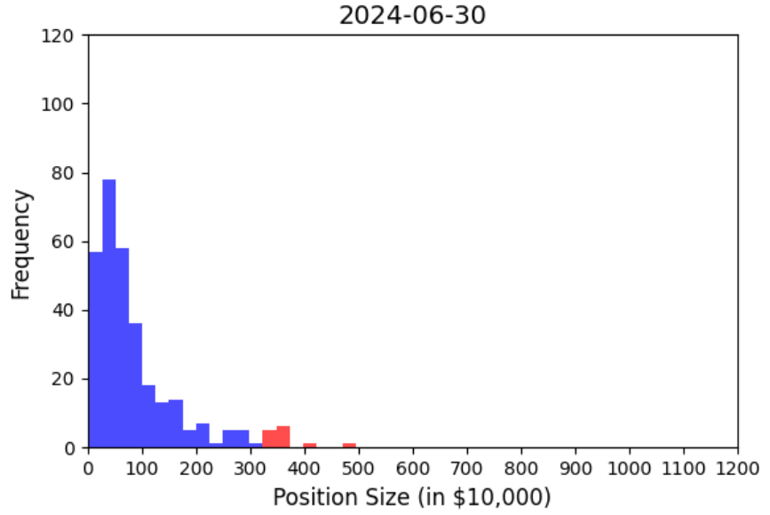
Progress of Diversified Investment Strategy 2022/12~2024/12
Bars with position sizes over $3 million are colored red.

Slide 29
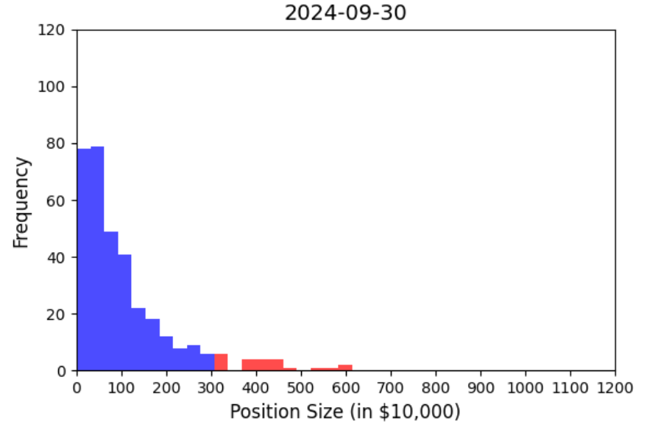
Progress of Diversified Investment Strategy 2022/12~2024/12
Bars with position sizes over $3 million are colored red.

Slide 30
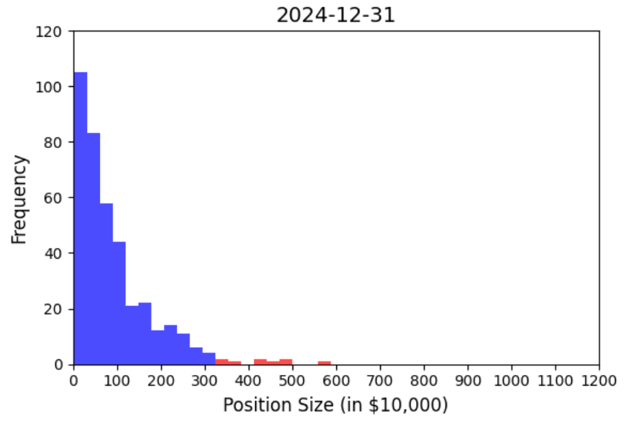
Progress of Diversified Investment Strategy 2022/12~2024/12
Bars with position sizes over $3 million are colored red.

Slide 31


分散投資戦略の進展 2022/12~2024/12 Progress of Diversified Investment Strategy 2022/12~2024/12
･The diversification of holdings has progressed, showing a tendency to hold a greater number of smaller positions.
･ The Numerai team is considered to have aimed to construct a portfolio with diversified holdings and a larger number of smaller positions.
･Turning points from June 30, 2023, to September 30, 2023?

Slide 32
The operational costs of Numerai as a DeAI

Slide 33
Operational Costs of Numerai as DeAI: New Contestant Entry and Retention
New Entry
･Previously, participants could receive a reward (5 NMR) by submitting a sample model. (I am unaware of the current status.)
･Enhancement of documentation
Retention Prevention
･Community Maintenance
Discord, Council of Elders
･Hosting various events
･Reward(NMR)
※Participants have long voiced concerns that rewards should be in stablecoins instead of NMR.

Slide 34
Operational Costs of Numerai as DeAI: Data and Rule Changes
Data Changes | Date | Staking | Affected 13F-HR/Reporting Date | Affected 13F-HR/Filing Date | Description
V4 | April 2022 | TC | 2022-12-31 | 2023-02-14 | Using V4 Data until 2023-11-30
V4.1 | December 2022 |  | 2022-12-31 | 2023-02-14
 |  |  | 2023-03-31 | 2023-05-12
 |  |  | 2023-06-30 | 2023-08-11
 |  |  | 2023-09-30 | 2023-11-13 | Using V4.1 Data until 2023-08-31
V4.2 | September 2023 |  | 2023-09-30 | 2023-11-13
 |  |  | 2023-12-31 | 2024-02-14
V4.3 | January 2024 | MMC staking starts Jan 2, 2024 | 2024-03-31 | 2024-05-15
 |  |  | 2024-06-30 | 2024-08-14
V5 | September 13, 2024 |  | 2024-09-30? | 2024-11-13? | Expands the dataset Universe to include more useful stocks.
https://mq-1.blogspot.com/2024/08/analysis-of-numerai-13f-hr-from.html
Since 2022, Numerai Tournament has never had the same data or staking rule for four quarters.
It seems that continuous review of data and rules is necessary to achieve good results.

Slide 35
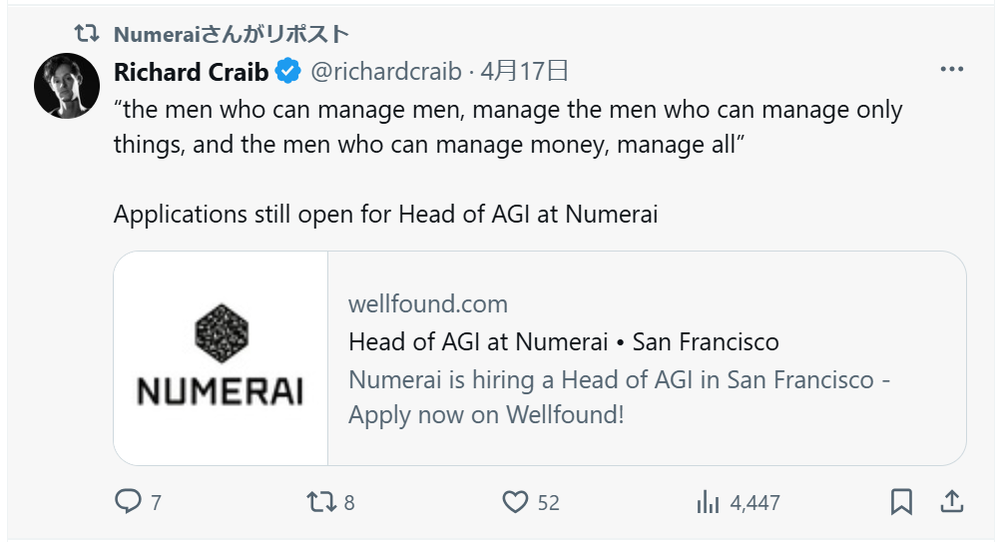
Numerai is urgently hiring AGI engineers! 🚀 Are Human Contestants Still Needed?
https://x.com/richardcraib/status/1912877741885567461

Slide 36
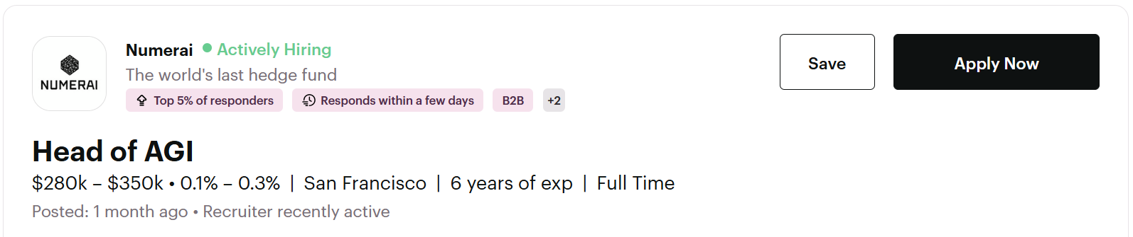
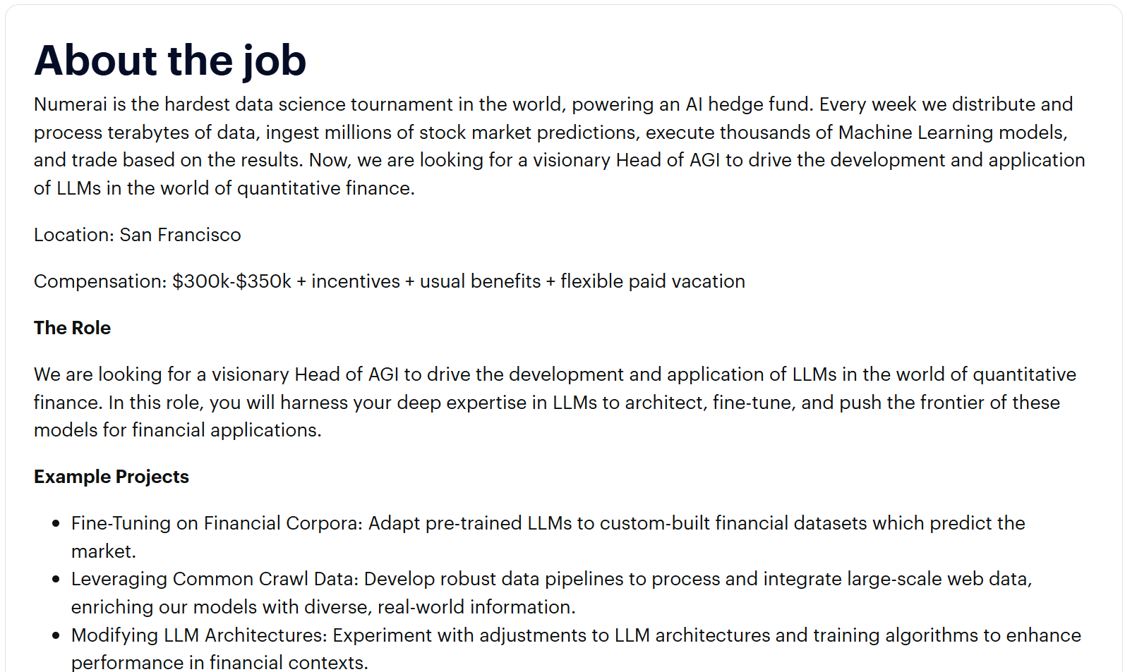
Operational Costs of Numerai as DeAI: Data and Rule Changes
https://wellfound.com/jobs/3231539-head-of-agi
This is a recruitment for AGI engineers to create datasets for market forecasting.
Numerai needs to invest in improving the datasets.
it seems that human participants are still required.

Slide 37
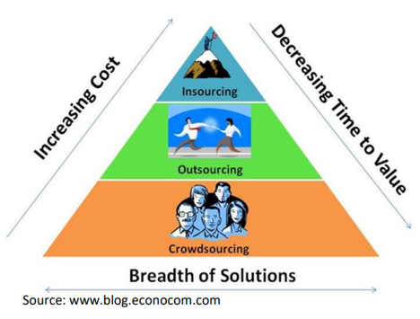
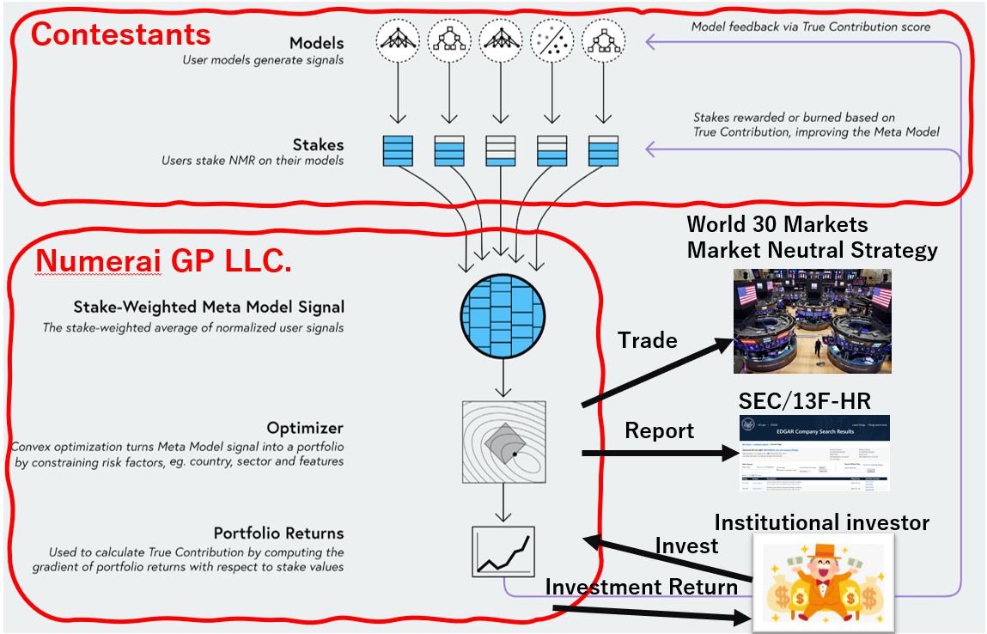
Conclusion
･Numerai as a DeAI Utilizing Crowdsourcing.
･While 13F-HR does not provide complete information, it may offer insights into trends in Numerai’s optimization algorithm (Optimizer) and potential shifts in strategy.
･DeAI is not the end goal after its construction; its ongoing operation requires costs, including the design of incentives to motivate participants, and the continuous review of data, rules, and optimization algorithms.

Slide 38
Thanks
The Numerai team has created and has been continuously operating "Numerai" to take on the financial markets.
I deeply appreciate their remarkable efforts and contributions.

Slide 39
Discussion & Q&A Summary
Q. Section “Operational Costs of Numerai as DeAI: Data and Rule Changes”
Did you understand the impact and effects of Data and Rule Changes from 13F-HR?
A. That's an interesting question. I didn't analyze it this time.
Since June 30, 2023, the dataset has undergone three changes (from V4.2 to V5), and the staking rule has changed once (from TC to MMC). I believe the Numerai team made these adjustments to improve prediction accuracy.

Slide 40
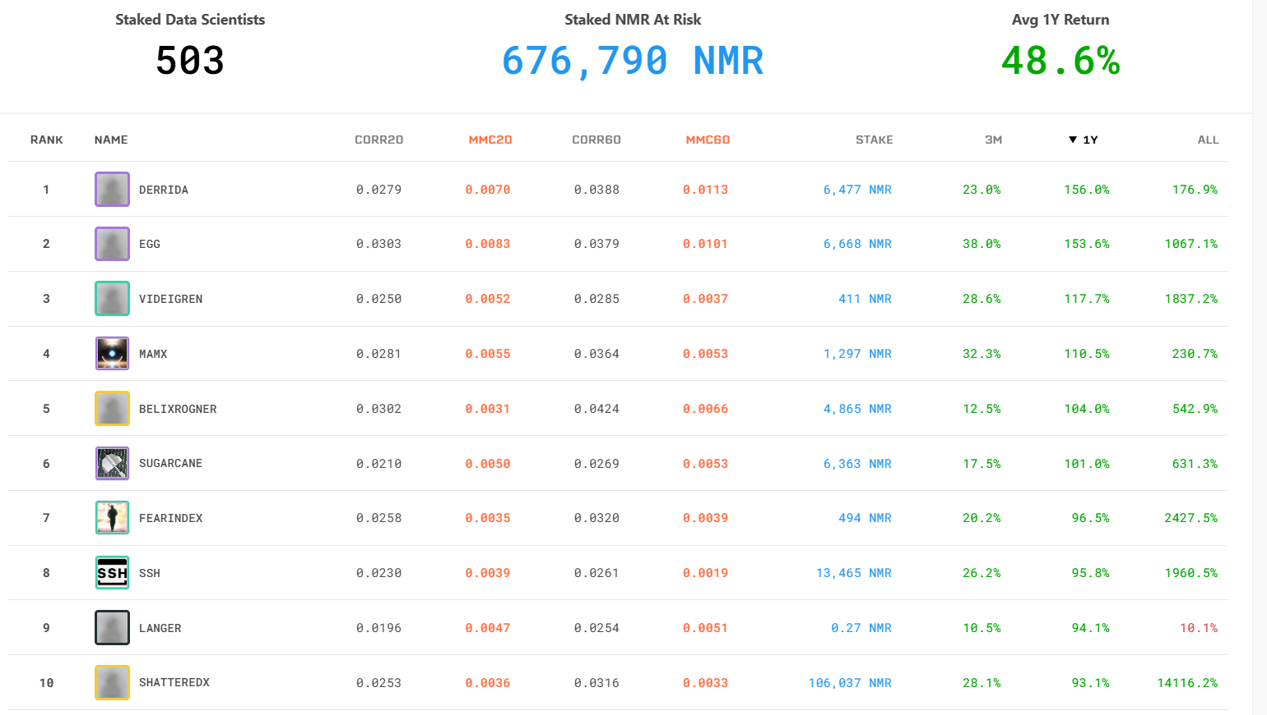
Discussion & Q&A Summary
Q. Section “Numerai and Stakeholders”
Is the Stake-Weighted Meta Model Signal functioning properly?
A. I’m curious about that too. Sometimes, even participants with strong performance have a relatively low stake amount. I feel like the Numerai team has been experimenting with various adjustments, including changes to the staking rules.
Numerai tournament leaderboard sorted by 1-year performance
https://numer.ai/leaderboard

Slide 41
Discussion & Q&A Summary
※It comes up as a topic in the Open Discussion.
Q. Section “Numerai and Stakeholders”
There could be cases where contestants work for companies that Numerai's hedge fund trades. Wouldn't that pose a risk of being suspected of insider trading?
A. The data provided by Numerai and the predictions submitted by participants are encrypted, making it practically impossible for an employee of a specific company to provide prediction values for that company. I'm not a legal expert, so I can't say for certain, but I imagine the details are outlined in their Terms of Service.

Slide 42
Unpresented Materials from Decentralized AI Day (Tokyo)
･Balancing Diversification and Concentrated Investment
I omitted it due to the small sample size.
･Trends in Turnover Ratio
I believe that the turnover rate does not accurately reflect the strong intentions of the Numerai hedge fund team.

Slide 43
Balancing Diversification and Concentrated Investment

Slide 44
Balancing Diversification and Concentrated Investment
Numerai seems to be aiming for diversification.
However, is Numerai's approach properly maintaining a balance between diversification and concentrated investment? Or is it aiming to achieve the realization of a stable hedge fund through diversification?

Slide 45
Performance of Outlier Positions with Large Allocations
If outlier positions with large allocations perform well, it might suggest that concentrated investment is working effectively.
The 13F-HR is a list of stocks held by institutional investors as of the end of the quarter.
The 13F-HR reflects the holdings at the end of the quarter, serving merely as a snapshot of that moment. Additionally, there may be stocks that were sold after the end of the following quarter.

Slide 46
Performance of Outlier Positions with Large Allocations
The following is a list of the top 5 stocks with large position sizes that were not reported in the 13F-HR as of June 30, 2024, and December 31, 2024, but were reported only in the 13F-HR as of September 30, 2024.
In other words, the following 5 stocks were likely bought between July 1, 2024, and September 30, 2024, and sold between October 1, 2024, and December 31, 2024.
If the stock prices of the following 5 stocks show an upward trend, it can be inferred that the Numerai team made a good concentrated investment.

Slide 47
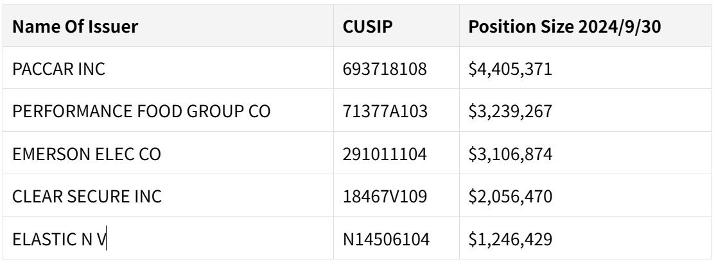
Performance of Outlier Positions with Large Allocations
I created graphs showing the price trends of the five stocks above.
The starting point of the red arrow represents the best buying opportunity, which is the lowest stock price between July 1, 2024, and September 30, 2024.
The ending point of the red arrow represents the best selling opportunity, which is the highest stock price between October 31, 2024, and December 31, 2024.

Slide 48
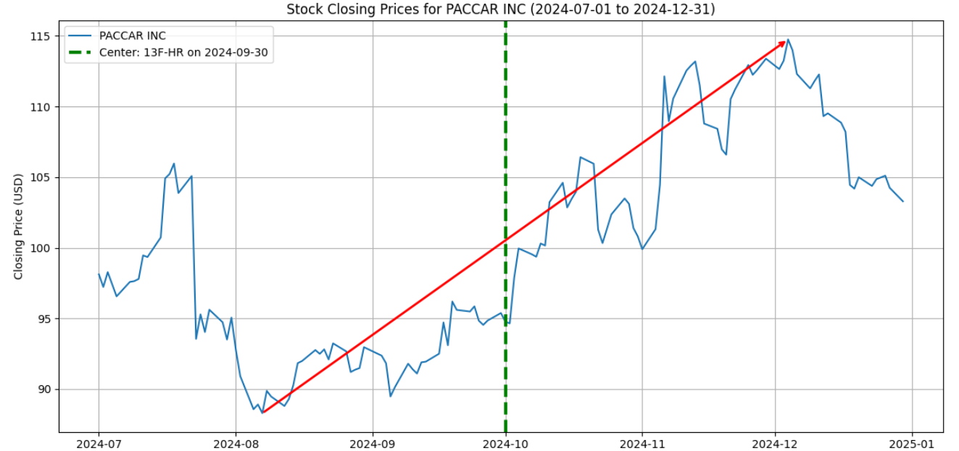
PACCAR INC

Slide 49
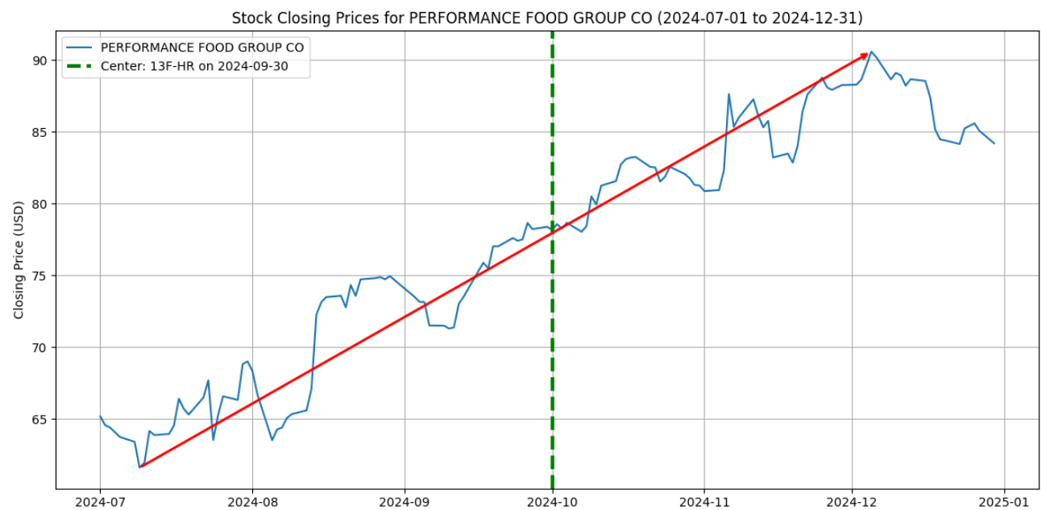
PERFORMANCE FOOD GROUP CO

Slide 50
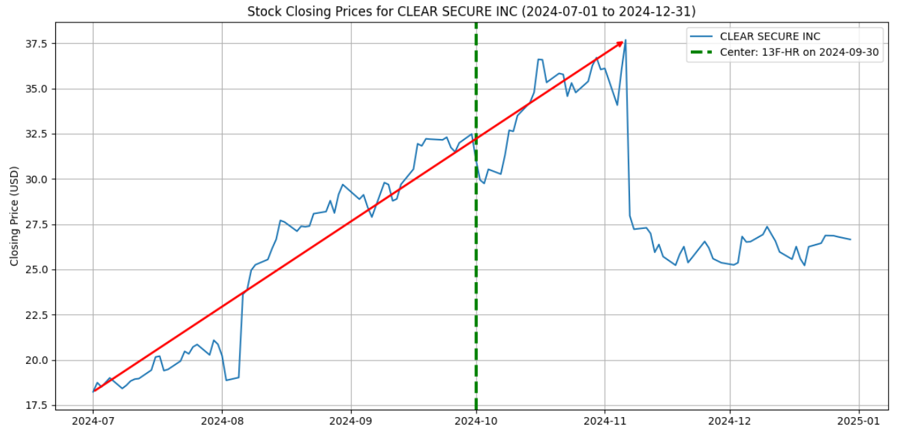
CLEAR SECURE INC

Slide 51
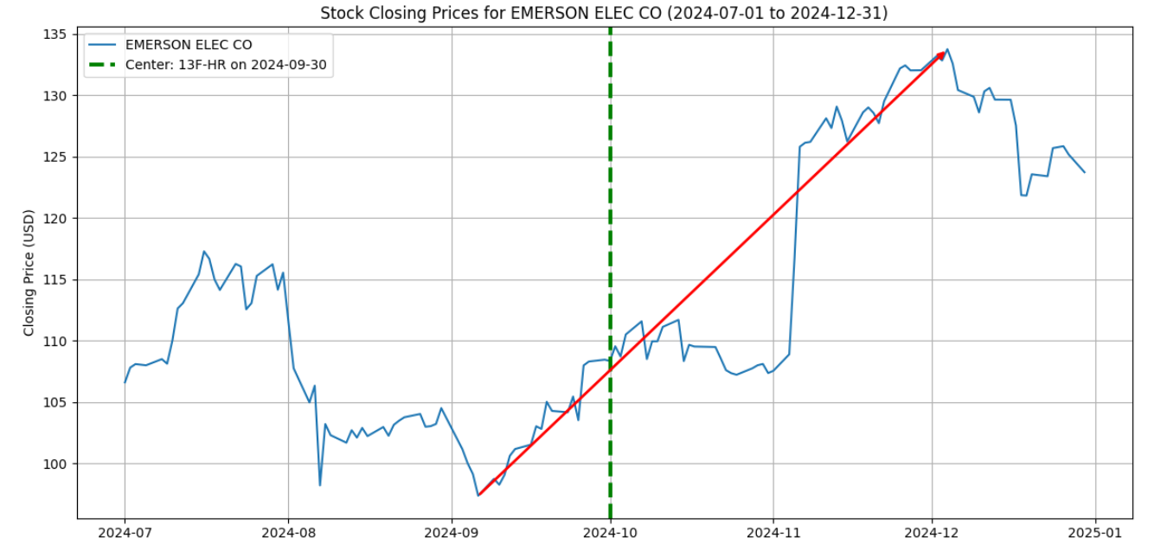
EMERSON ELEC CO

Slide 52
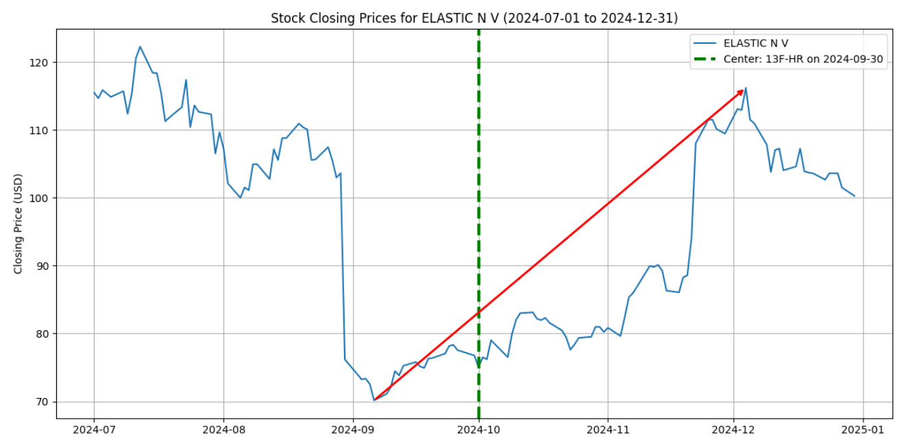
ELASTIC N V

Slide 53
Thoughts
･These are merely sample stocks, but to me, it seemed like a significant position was in an upward trend.
･However, as indicated by the red arrows, it cannot be confirmed whether the trades were executed at the optimal timing. Based on the information from the 13F-HR, it cannot be asserted that Numerai executed trades at the best timing and effectively pursued a concentrated investment strategy.

Slide 54
Trends in Turnover Ratio

Slide 55
Trends in Turnover Ratio

Slide 56
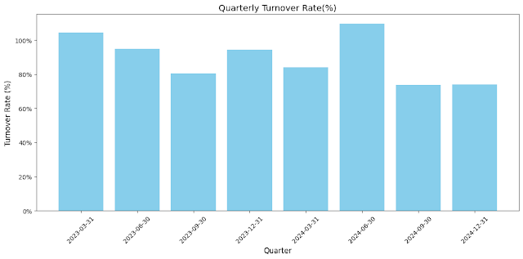
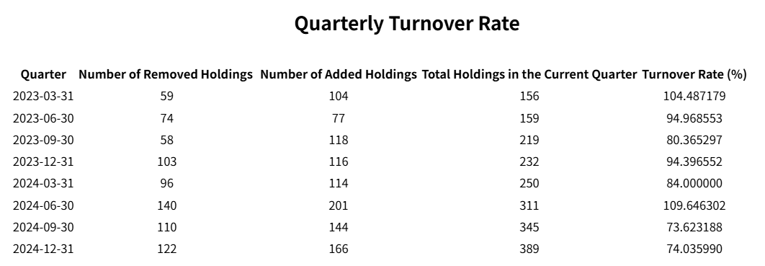
Trends in Turnover Ratio

Slide 57
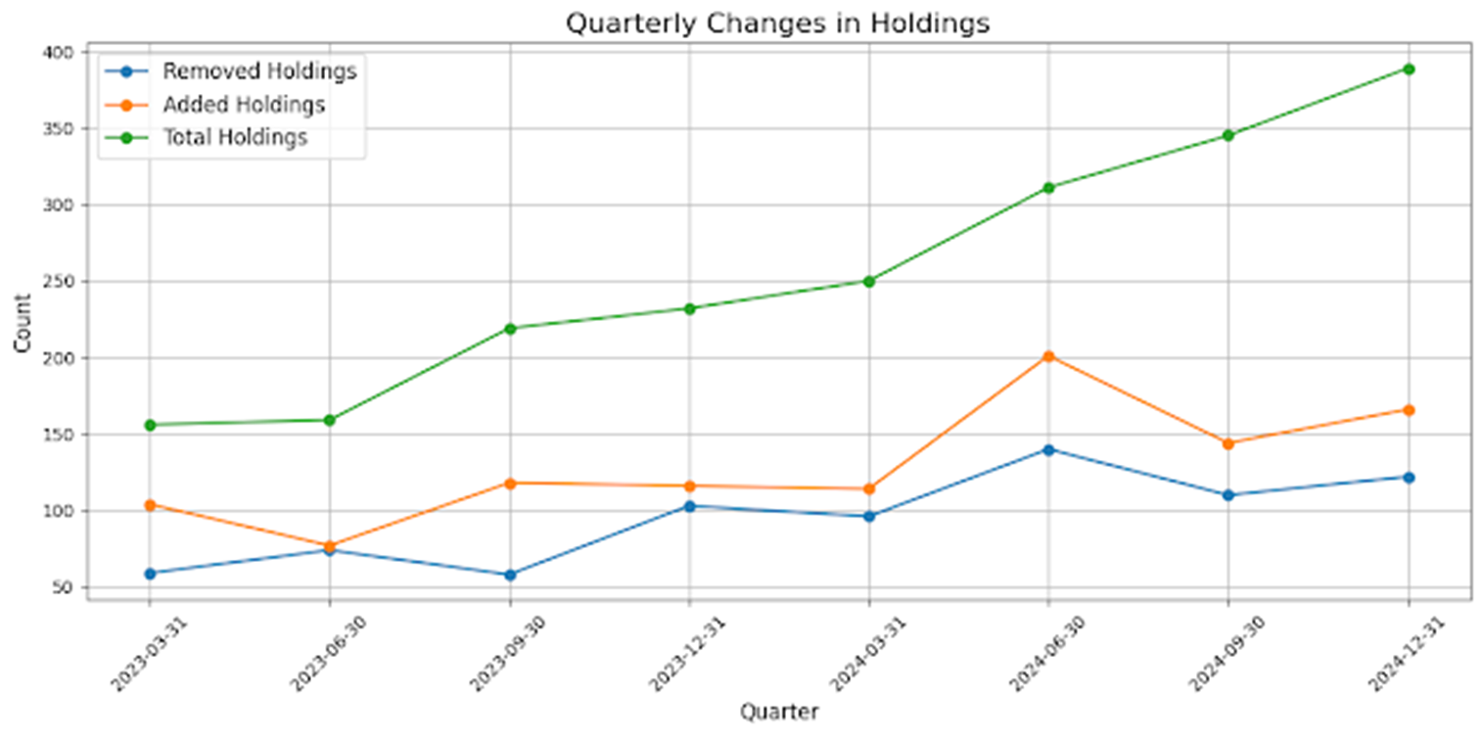
Trends in Turnover Ratio
I feel that the Turnover Rate does not reflect the same strong intention of the Numerai hedge fund team as the Number of Holdings or Position Size.

Slide 58
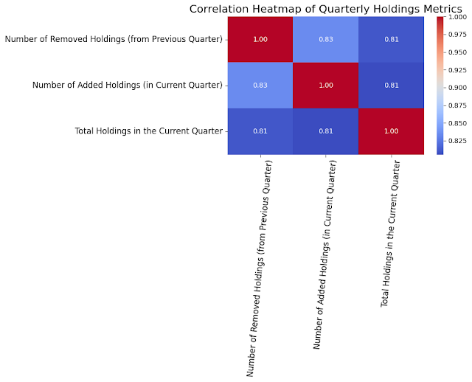
Trends in Turnover Ratio
The addition and removal of holdings are correlated with Total Holdings.
As the total holdings change, the number of additions and removals of holdings appears to increase or decrease accordingly.

Slide 59
Contacts
LinkedIn: Kei Sanada https://www.linkedin.com/in/kei-sanada/
X (Twitter): @sdk7777
Addition:
The new 13F-HR of Numerai was announced on May 15.
I will also summarize it in my blog. https://mq-1.blogspot.com

Slide 60
DeAIとしてのNumerai：13F-HRの分析と運用コストについて Numerai as Decentralized AI: Insights from 13F-HR and Operational Costs
Decentralized AI Day (Tokyo)
Saturday, May 17, 2025
Kei Sanada 眞田 啓

Slide 61
免責事項 Disclaimer
･この文書に記載されている見解は、著者自身のものであり、必ずしもNumerai, Inc.の見解を反映するものではありません。
･この文章は、いかなる投資判断や特定の行動方針を推奨するものではありません。
･この文章によっていかなる損害を受けても、著者は責任を持ちません。
･The views expressed in this document are the author's own and do not necessarily reflect those of Numerai, Inc.
･No investment decision or particular course of action is recommended by this document. ･The author assumes no responsibility for any damages incurred as a result of this document.

Slide 62
ご理解いただきたいこと Things to Understand
･Decentralized AI Day (Tokyo)は日本語ネイティブでない方も参加されています。
･日本語ネイティブでない方のご理解の一助になるように資料に日本語、英語が混在しています。
･そのため読みにくい資料になっていることご容赦ください。
･Decentralized AI Day (Tokyo) includes participants who are not native Japanese speakers.
･To assist their understanding, this document contains both Japanese and English.
･I appreciate your understanding as this may make the materials somewhat difficult to read.

Slide 63
概要 Summary
･Decentralized AIとしてのNumerai
･Numeraiの特徴を13F-HRから読み解くことができるか？
･DeAIとしてのNumeraiの運用コストについて
･本書の対象外
暗号資産 Numeraire (NMR)の今後、価格予測
･Numerai as Decentralized AI
･Can I analyze the characteristics of Numerai from 13F-HR?
･The operational costs of Numerai as a DeAI
･Not covered in this document:
Future outlook and price predictions for the cryptocurrency Numeraire (NMR)

Slide 64
Decentralized AIとしてのNumerai 論文「Advances in Financial Machine Learning:Numerai‘s Tournament」を再読 Numerai as Decentralized AI Revisiting the Paper: Advances in Financial Machine Learning-Numerai’s Tournament If you already know this paper, just let it go. Lopez de Prado, M. (2019). Advances in Financial Machine Learning: Numerai‘s Tournament. Cornell University - Operations Research & Industrial Engineering; Abu Dhabi Investment Authority; True Positive Technologies. Retrieved from https://papers.ssrn.com/sol3/papers.cfm?abstract_id=3478927

Slide 65
Decentralized AIとしてのNumerai Numerai as Decentralized AI
Numerai Tournament Scoring True Contribution (TC)
https://docs.numer.ai/numerai-tournament/scoring/true-contribution-tc
※True Contribution (TC) は現在、利用されていません 。True Contribution (TC) is currently not in use.

Slide 66
Numeraiとステークホルダ Numerai and Stakeholders
Contestants
World 30 Markets
Market Neutral Strategy
Numerai GP LLC.
Trade
SEC/13F-HR
Report
Institutional investor
Invest
Investment Return
Numerai Tournament Scoring True Contribution (TC)
https://docs.numer.ai/numerai-tournament/scoring/true-contribution-tc
True Contribution (TC) は現在、利用されていません。 True Contribution (TC) is currently not in use.

Slide 67
Advances in Financial Machine Learning: Numerai‘s Tournament
･「Advances in Financial Machine Learning: Numerai‘s Tournament」が発表された2019年当時、DeAIという概念が一般的ではなかったので、「CrowdSourced Resarch」、「Tornament」という言葉を使ってNumeraiについて説明がされています。
Lopez de Prado, M. (2019). Advances in Financial Machine Learning: Numerai‘s Tournament. Cornell University - Operations Research & Industrial Engineering; Abu Dhabi Investment Authority; True Positive Technologies.
Retrieved from https://papers.ssrn.com/sol3/papers.cfm?abstract_id=3478927
･2024年の「SoK: Decentralized AI (DeAI)」では、NumeraiはDeAIプロジェクトとして取り上げられています。
Wang, Z., Sun, R., Lui, E., Shah, V., Xiong, X., Sun, J., Crapis, D., & Knottenbelt, W. (2024). SoK: Decentralized AI (DeAI). arXiv preprint. https://arxiv.org/abs/2411.17461

Slide 68
Advances in Financial Machine Learning: Numerai‘s Tournament
･In 2019, when 'Advances in Financial Machine Learning: Numerai’s Tournament' was published, the concept of DeAI was likely not widely recognized. Therefore, Numerai was described using the terms 'Crowdsourced Research' and 'Tournament.’
Lopez de Prado, M. (2019). Advances in Financial Machine Learning: Numerai‘s Tournament. Cornell University - Operations Research & Industrial Engineering; Abu Dhabi Investment Authority; True Positive Technologies.
Retrieved from https://papers.ssrn.com/sol3/papers.cfm?abstract_id=3478927
･In the 2024 paper 'SoK: Decentralized AI (DeAI),' Numerai is presented as a DeAI project.
Wang, Z., Sun, R., Lui, E., Shah, V., Xiong, X., Sun, J., Crapis, D., & Knottenbelt, W. (2024). SoK: Decentralized AI (DeAI). arXiv preprint. https://arxiv.org/abs/2411.17461

Slide 69
現代のクオンツリサーチにおける障害 The Handicaps to Modern Quantitative Research
Numerai

Slide 70
現代のクオンツリサーチにおける障害 The Handicaps to Modern Quantitative Research:Silo
The Old Paradigm : Silo
従来、クオンツチームは、それぞれ独立した存在として活動してきました。そのため、1つの会社がカバーできる投資戦略の種類は、雇用できるチームの数に制限されていました。
Traditionally, quant teams have worked and operated as silos.
A firm’s ability to cover multiple investment strategies is limited by how many teams it can hire.

Slide 71
現代のクオンツリサーチにおける障害 The Handicaps to Modern Quantitative Research:CrowdSourced Resarch
CrowdSourced Resarch

Slide 72
現代のクオンツリサーチにおける障害:Silo型の課題 The Handicaps to Modern Quantitative Research:Handicap of Silo
Handicap #1: 経験による障壁
投資戦略を開発するには、専門的な知識が必要とされます。そのため、多くのデータサイエンティストがこの分野に参加できません。
Handicap #2: データ/リソースの障壁
高額なデータセット、ソフト、ハードが必要です。一般的な公開情報から投資機会を見つけられる時代は終わり、高度な分析のため複雑なデータセットの購入、管理、分析、高スペックなコンピュータ、ソフトに多額の費用が掛かります。
Handicap #3: 選択バイアス
研究者は、良いパフォーマンスを示すバックテストを作成することで報酬を得ています。そのためモデルを過剰適合しがちです。また、企業は場合によっては、過剰適合したバックテストを利用して投資家から資金を集めるため、それを助長することさえあります。

Slide 73
現代のクオンツリサーチにおける障害:Tournament型による解決 The Handicaps to Modern Quantitative Research:Tournament
Tournament
Handicap #1: 経験による障壁
経験豊富な研究者によって前処理、構造化されてデータが提供された状態で、参加者は予想に取り組むことができます。
Handicap #2: データ/リソースの障壁
高額なデータセットは不要で、予測に必要なデータが利用可能です。
一般的ではありませんが、遠隔操作で複数のコンピュータを使って大規模な計算ができる環境が提供される場合もあります。
Handicap #3: 選択バイアス
トーナメントは、公平なルールを作ることで選択バイアスが発生しないように設計できる。また、もしバイアスが発生しても、その影響を考慮して調整できる。

Slide 74
Numeraiの特徴を13F-HRから読み解くことができるか？ Can I analyze the characteristics of Numerai from 13F-HR?

Slide 75
13F-HR
1億ドル以上の資産を管理する機関投資家が、四半期毎SECへ13F-HR報告書を提出することを求められます。
･13F-HRに記載されている銘柄はロングポジション。ショートポジションは記載されていません。
･SECのリストに記載がある米国市場で取引される証券が記載されいます。
-株式、クローズドエンド投資会社（クローズドエンドファンド）の株式、上場投資信託（ETF）の株式、特定の転換社債、株式オプション、およびワラントのロングポジション
-米国預託証券（ADR）を通じて、日本、ヨーロッパ、中国などの銘柄が含まれる場合がある。

Slide 76
13F-HR
Institutional investors managing over $100 million in assets are required to submit a 13F-HR report to the SEC on a quarterly basis.
･The securities listed in 13F-HR are long positions; short positions are not included.
･ Only securities traded in the U.S. markets and listed on the SEC’s approved list are reported.
Covered asset types include:
- Equities, shares of closed-end investment companies (closed-end funds), exchange-traded fund (ETF) shares, certain convertible bonds, stock options, and warrants (long positions only).
- Through American Depositary Receipts (ADRs), securities from Japan, Europe, China, and other regions may be included.

Slide 77
Numeraiヘッジファンドの保有銘柄、パフォーマンス Numerai Hedge Fund Holdings and Performance
Numeraiヘッジファンド（Numerai GP LLC. )の保有銘柄、パフォーマンスは公表されていません。
※一部、medium.comの記事として発表されたことはあります。
Numeraiヘッジファンドの13F-HRを参照すれば、ロングポジションだけですが、四半期末時点にどの銘柄を保有していたか、把握することができます
Numerai Hedge Fund (Numerai GP LLC.) does not disclose its holdings or performance.
※Some articles have been published on Medium.com.
By referencing Numerai Hedge Fund’s 13F-HR filings, one can see its long positions and identify the stocks held at the end of each quarter.

Slide 78
ロングポジションの運用資産残高 四半期毎 Long Position Assets Under Management (Quarterly)
※Assets Under Management

Slide 79
2024年のパフォーマンス Performance in 2024
おそらく2024年は順調に成長したと思われます。
It is likely that 2024 saw steady growth.
https://t.co/n45jK4vLtn

Slide 80
保有銘柄数の変化
Date AUM ($1B) Holdings
2022/12/31 $0.15 111
2023/3/31 $0.30 156
2023/6/30 $0.49 159
2023/9/30 $0.30 219
2023/12/31 $0.28 232
2024/3/31 $0.23 250
2024/6/30 $0.28 311
2024/9/30 $0.38 345
2024/12/31 $0.37 389
AUMと保有銘柄数の相関係数は 0.288 で、それほど高くはありません。
保有銘柄数はAUMの変動に応じて増減しているわけではないようです。Numerai チームは、ポートフォリオの分散を図るために、AUMとは独立して保有銘柄数を増やしているようです。

Slide 81
Changes in the Number of Holdings
Date AUM ($1B) Holdings
2022/12/31 $0.15 111
2023/3/31 $0.30 156
2023/6/30 $0.49 159
2023/9/30 $0.30 219
2023/12/31 $0.28 232
2024/3/31 $0.23 250
2024/6/30 $0.28 311
2024/9/30 $0.38 345
2024/12/31 $0.37 389
The correlation between AUM and the number of holdings is weak, with a coefficient of 0.288.
Holdings don’t seem to fluctuate in direct response to AUM changes. Instead, the Numerai team appears to adjust the number of holdings independently to enhance portfolio diversification.

Slide 82
分散投資戦略の進展 Progress of Diversified Investment Strategy
I created boxplot charts for the position sizes in each 13F-HR.
The initial 13F-HR data presents a surprising deviation, with a notably higher occurrence of upper outliers than anticipated.

Slide 83
Progress of Diversified Investment Strategy 2022/12~2024/12
Bars with position sizes over $3 million are colored red.

Slide 84
Progress of Diversified Investment Strategy 2022/12~2024/12
Bars with position sizes over $3 million are colored red.

Slide 85
Progress of Diversified Investment Strategy 2022/12~2024/12
Bars with position sizes over $3 million are colored red.

Slide 86
ロングポジションの運用資産残高 四半期毎 Long Position Assets Under Management (Quarterly)
※Assets Under Management
Did you mess up something?

Slide 87
Progress of Diversified Investment Strategy 2022/12~2024/12
Bars with position sizes over $3 million are colored red.

Slide 88
分散投資戦略の進展 2023-07 ~ 2023-09 Progress of Diversified Investment Strategy 2023-07~ 2023-09
※Assets Under Management
The diversification of holdings has progressed.

Slide 89
Progress of Diversified Investment Strategy 2022/12~2024/12
Bars with position sizes over $3 million are colored red.

Slide 90
Progress of Diversified Investment Strategy 2022/12~2024/12
Bars with position sizes over $3 million are colored red.

Slide 91
Progress of Diversified Investment Strategy 2022/12~2024/12
Bars with position sizes over $3 million are colored red.

Slide 92
Progress of Diversified Investment Strategy 2022/12~2024/12
Bars with position sizes over $3 million are colored red.

Slide 93
Progress of Diversified Investment Strategy 2022/12~2024/12
Bars with position sizes over $3 million are colored red.

Slide 94
分散投資戦略の進展 2022/12~2024/12 Progress of Diversified Investment Strategy 2022/12~2024/12
・保有資産の分散が進み、より多くの小規模なポジションを保有する傾向が見られます。
・Numerai チームは、分散された保有資産、より多くの小規模なポジションを持つポートフォリオの構築を目指したと考えられます。
・転換点は2023/06/30から2023/09/30 ?
･The diversification of holdings has progressed, showing a tendency to hold a greater number of smaller positions.
･ The Numerai team is considered to have aimed to construct a portfolio with diversified holdings and a larger number of smaller positions.
･Turning points from June 30, 2023, to September 30, 2023?

Slide 95
DeAIとしてのNumeraiの運用コスト The operational costs of Numerai as a DeAI

Slide 96
DeAIとしてのNumeraiの運用コスト:参加者の新規参入と離反防止
新規参入
･以前はサンプルモデルをサブミットすることで報酬(5NMR)を得ることができた。（現在は不明）
･ドキュメントの充実
離反防止
･コミュニティの維持
Discord、長老会議(Council of Elders)
･各種イベントの開催
･報酬（NMR)
※報酬をNMRではなく、ステーブルコインにすべきという参加者からの声は以前から上がっている

Slide 97
Operational Costs of Numerai as DeAI: New Contestant Entry and Retention
New Entry
･Previously, participants could receive a reward (5 NMR) by submitting a sample model. (I am unaware of the current status.)
･Enhancement of documentation
Retention Prevention
･Community Maintenance
Discord, Council of Elders
･Hosting various events
･Reward(NMR)
※Participants have long voiced concerns that rewards should be in stablecoins instead of NMR.

Slide 98
DeAIとしてのNumeraiの運用コスト:データ、ルール変更 Operational Costs of Numerai as DeAI: Data and Rule Changes
Data Changes | Date | Staking | Affected 13F-HR/Reporting Date | Affected 13F-HR/Filing Date | Description
V4 | April 2022 | TC | 2022-12-31 | 2023-02-14 | Using V4 Data until 2023-11-30
V4.1 | December 2022 |  | 2022-12-31 | 2023-02-14
 |  |  | 2023-03-31 | 2023-05-12
 |  |  | 2023-06-30 | 2023-08-11
 |  |  | 2023-09-30 | 2023-11-13 | Using V4.1 Data until 2023-08-31
V4.2 | September 2023 |  | 2023-09-30 | 2023-11-13
 |  |  | 2023-12-31 | 2024-02-14
V4.3 | January 2024 | MMC staking starts Jan 2, 2024 | 2024-03-31 | 2024-05-15
 |  |  | 2024-06-30 | 2024-08-14
V5 | September 13, 2024 |  | 2024-09-30? | 2024-11-13? | Expands the dataset Universe to include more useful stocks.
https://mq-1.blogspot.com/2024/08/analysis-of-numerai-13f-hr-from.html
2022年以降、Numeraiトーナメントでは、4四半期連続で同じデータやステーキングルールが適用されたことはありません。
良い結果を出すために、継続的なデータ、ルールの見直しが必要なようです。
Since 2022, Numerai Tournament has never had the same data or staking rule for four quarters.
It seems that continuous review of data and rules is necessary to achieve good results.

Slide 99
Numerai is urgently hiring AGI engineers! 🚀 Are Human Contestants Still Needed?
https://x.com/richardcraib/status/1912877741885567461

Slide 100
DeAIとしてのNumeraiの運用コスト:データ、ルール変更 Operational Costs of Numerai as DeAI: Data and Rule Changes
https://wellfound.com/jobs/3231539-head-of-agi
市場予測のためのデータセットを作成する汎用人口知能（AGI）エンジニアの募集です。
データセットの改善に投資が必要です。
(まだ人間の参加者は必要なようです)
This is a recruitment for AGI engineers to create datasets for market forecasting.
Numerai needs to invest in improving the datasets.
it seems that human participants are still required.

Slide 101
結論
･NumeraiはCrowdsourcingを活用したDeAIです。
･13F-HRは不完全な情報ですが、Numeraiの最適化アルゴリズムの傾向や、方針変更を読み取れる可能性があります。
･DeAIは構築すれば終わりでは無く、その運用に、参加者のインセンティブ設計、データ・ルール、最適化アルゴリズムの継続的な見直しなどのコストが掛かります。
･Numerai as a DeAI Utilizing Crowdsourcing.
･While 13F-HR does not provide complete information, it may offer insights into trends in Numerai’s optimization algorithm (Optimizer) and potential shifts in strategy.
･DeAI is not the end goal after its construction; its ongoing operation requires costs, including the design of incentives to motivate participants, and the continuous review of data, rules, and optimization algorithms.

Slide 102
Thanks
Numeraiチームは、金融市場へ挑戦するため「Numerai」を創り出し、継続的に運用しています。
その卓越した努力と貢献に敬意を表します。
The Numerai team has created and has been continuously operating "Numerai" to take on the financial markets.
I deeply appreciate their remarkable efforts and contributions.

Slide 103
Contacts
LinkedIn: Kei Sanada https://www.linkedin.com/in/kei-sanada/
X (Twitter): @sdk7777
Addition:
The new 13F-HR of Numerai was announced on May 15.
I will also summarize it in my blog. https://mq-1.blogspot.com

